Slide 1
Predicting Future Patients
Kenny Thomas, Kyle Johnson, Doug McGuire

Slide 2

Table of Contents
Research Questions
Data Introduction
Part One: Predicting Returned Patients
Business Implications for Return Model
Part Two: Exploring Relationships among Body Regions
Business Implications for Body Region Model
Moving Forward

Slide 3
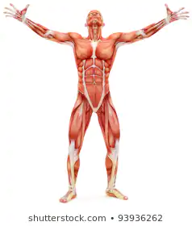
IMC Mission Statement
“To reduce the incidence, prevalence, and costs associated with musculoskeletal disorders.”

Slide 4
Research Questions

Slide 5
Research Questions
Can we build a model to predict if a patient will return based off of their first visit information?
Using these predicted return results, can we predict whether they will come back for a different body region?
Can we identify significant associations between the body regions for which patients return?

Slide 6

Research Implications
If we can obtain accurate models, we can help the business by reducing costs, improving staffing levels, and providing tools to market their services as a better preventative solution

Slide 7
Data Introduction

Slide 8
Data Set 1
14 features in the data set
Patient Information: EMID, Gender, FVage
Case/Procedure Information: Date, allowed, ICD, Procedure, DX, BRalpha, PLalias, MaxPL, FVL, FVrrisk, CSID
Data was collected from January of 2012 to December of 2016
Data was collected from outside network of patients, not from IMC patients
Patient and case information for 18,416 different patients
Over 330,000 entries indicating the number of procedures performed
About half of the patients came in for only one case, the other half came in for multiple different cases

Slide 9
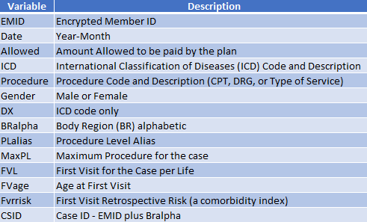
Given Variable Descriptions

Slide 10

Drop Rows with N/A Values
Drop N/A Values using the dropna method
Reduced from 349,023 rows down to 331,011
18,012 row reduction
Leaves us with 95% of our original data

Slide 11
Categorical Variables Breakdown
Gender: 9,495 Females and 8,921 Males
ICD: 1,607 unique codes, top was “7242-Lumbago (low back pain)”
Procedure: 2,175 unique procedures, top was “97110 -Therapeutic Exercises”
BRalpha: 20 body parts, Lumbar and Cervix were most frequent
DX: 1,607 unique codes (same as the ICD w/o description)
PLalias: 11 unique values, Therapy was the most common with twice as many instances as the next highest

Slide 12
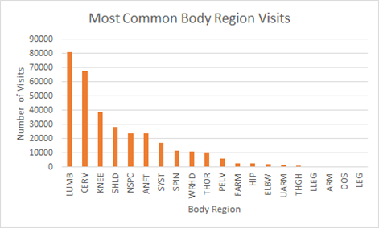
Common Body Regions
Top Three Regions:
Lumbar
Cervix
Knee

Slide 13
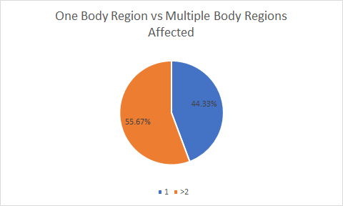
Body Regions Affected
8,163 Single body region instances
10,253 Multiple body region instances

Slide 14
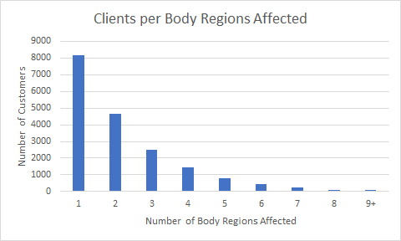

Slide 15
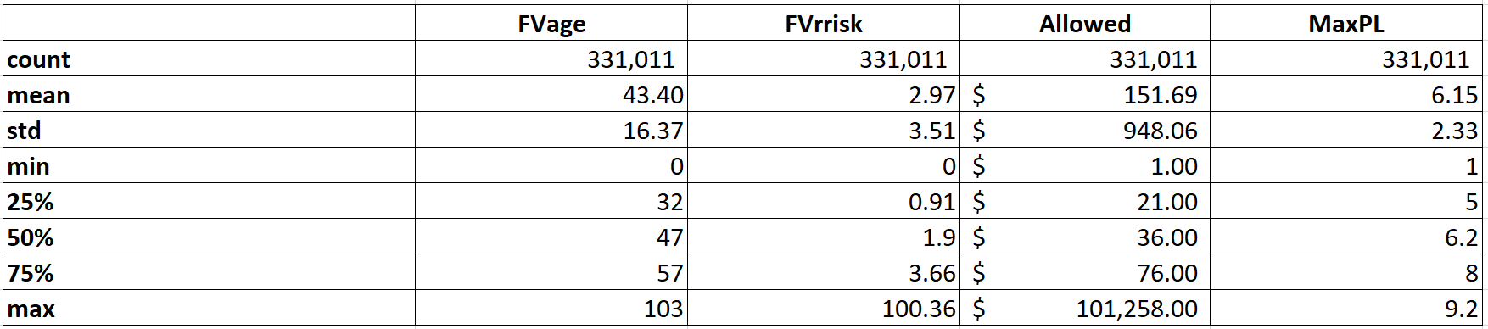
Continuous Variables Breakdown

Slide 16
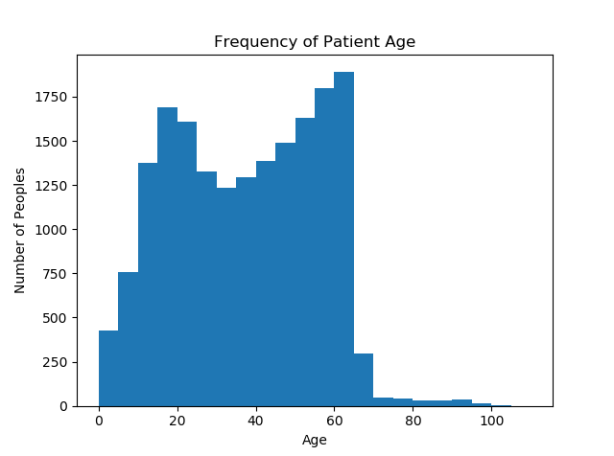
Patient Age
Most common:
60’s
Lumbar, Knee
20’s
More interesting
Most likely sports injuries
30-40’s
Most likely comprised of cervix issues

Slide 17
Part 1: Predicting if a Patient Will Return Based off First Visit Information

Slide 18
Variable Creation for Part 1
Date to Month/Year Purpose: Allows us to analyze the date more granularly Characteristics: Continuous variable, has a column for the month and year | Unique EMID Dataframe Purpose: Used to store information about individual patients Characteristics: Dataframe with overall characteristics for each unique patient | Returned Purpose: Tells us if a patient visited a clinic once or more than once Characteristics: Binary categorical - 1 for returned; 0 for one-time patient

Slide 19
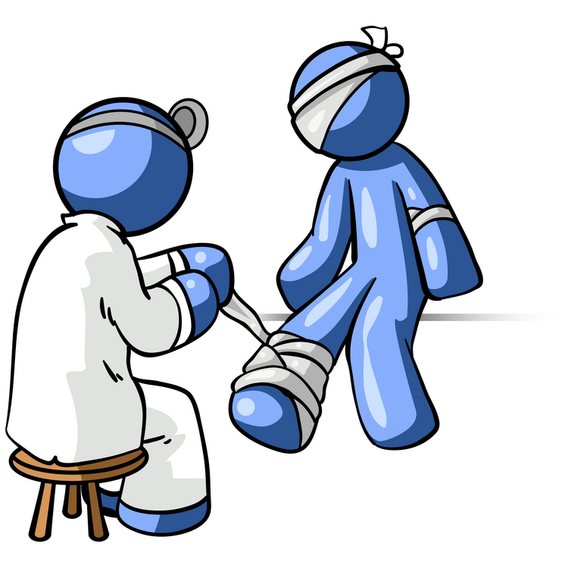
Split
Split data according to whether or not the patient returned for multiple visits
Results:
9,258 Multiple case patients
9,158 One case patients

Slide 20
Initial Feature Selection

Slide 21
Variables in Dataframe
EMID
Month
Year
Allowed
ICD
Procedure
Gender
DX
BRalpha
PLalias
MaxPL
FVL
FVage
Fvrrisk
CSID
Returned

Slide 22
Important Variables
EMID - Unique identifier that does not provide predictive information. Will be used in the data to track patients, but will not be used predictively
Returned - Our dependent variable. This is what we will be predicting during this part of the analysis

Slide 23
Justification for Excluding variables
ICD - Our study is concerned with the patient’s afflicted body region rather than their diagnoses
Procedure - PLalias provides a more general variable with much of the same information
DX - We are not concerned with the disease of the patient as we want the study to focus on body regions
FVL - We will later create the ‘Months as Patient’ variable that may be of more use
MaxPL - Maximum Procedure Level could skew the data concerning the initial - more minor - visits
CSID - Unique Case ID that lacks predictive power and, if included, would cause the data to overfit

Slide 24
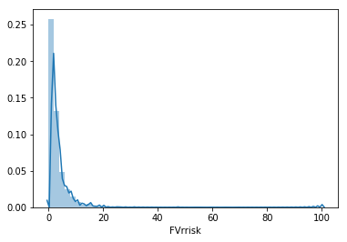
FVrrisk Exclusion
There is a heavy concentration of FVrrisk levels below 10
With most patients being in this small range, and with the relatively little information we have about how this variable is calculated, we decided to remove it from consideration

Slide 25
Variables Remaining
EMID
Month
Year
Allowed
ICD
Procedure
Gender
DX
BRalpha
PLalias
MaxPL
FVL
FVage
Fvrrisk
CSID
Returned

Slide 26


Data Preparation
One Hot Encode
Merge Dataframes
Train/Test Split
dfY includes “Returned”
dfX holds everything else

Slide 27
Return Model

Slide 28
Model Overview
Goal: To predict “Returned”, a binary variable
Requires a binary prediction
Only use data from a patient’s first visit
Trying to simulate real time
Models Chosen:
Logistic Regression
Random Forest
ADAboost
XGBoost

Slide 29

Boosting Algorithms
Create strong classifiers from a number of weak classifiers
Builds a model from training data
Creates a second model that attempts to correct the errors of the first model
Models are added until the training set is perfectly predicted, or a maximum number of models are added

Slide 30
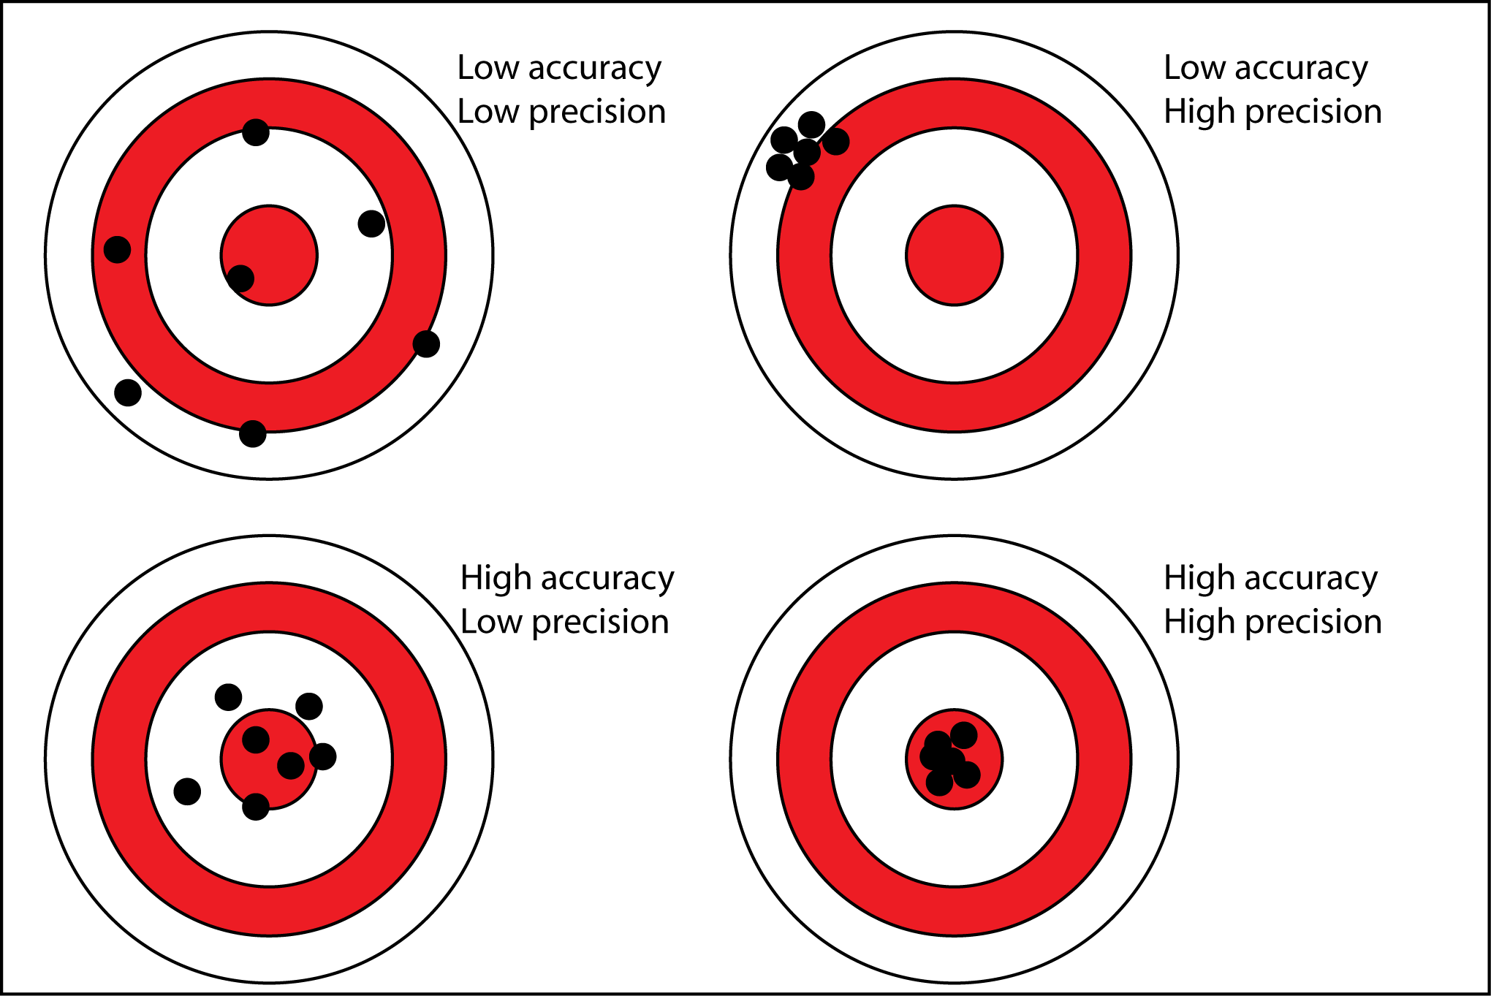
Model Evaluation
WIll be evaluating models based off accuracy scores
We are more concerned with being able to predict a patient’s proper category rather than:
Capturing all patients who returned (recall)
Making sure that the patients who were predicted to return actually returned (precision)

Slide 31
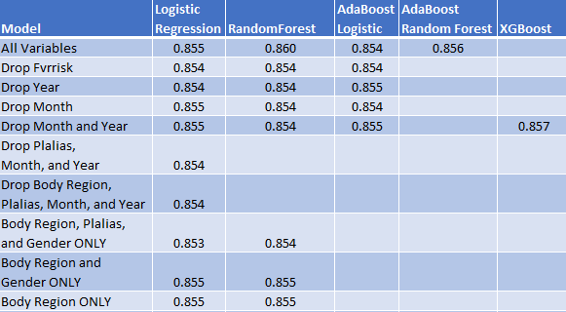
Model Accuracy Results

Slide 32
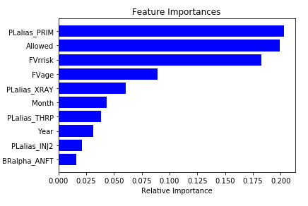
Random Forest Feature Importance

Slide 33
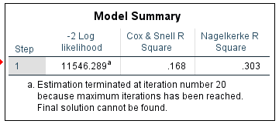
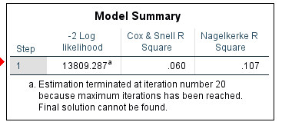
R Squared
With:
PLalias
BRalpha
Gender
Removing:
PLalias

Slide 34
R Squared Explained
Cox & Snell and Nagelkerke are adjusted R square measures which are used for binary dependent variables.
Shows that we get a decent R squared with including PLalias.
Our accuracy drops significantly without PLalias
PLalias has strong predictive power
But it shows that there is something we are not including that could improve our model

Slide 35
Business Implications for Return Model

Slide 36
How an Accurate Predictive Model Can Help IMC
Give extra attention to patients with features that have an increased likelihood of returning for another case
This in turn can help reduce costs (preventative treatment reduces the need for more visits)
Side benefit with “word of mouth” between patients and possible future patients
Help forecast staffing needs, i.e. if we have (x) patients likely to return during time period (t) we need (y) doctors/specialists to fulfill demand
Reduce costs of data collection

Slide 37
Part 2: Exploring the Relationships among Body Regions

Slide 38
Variable Creation for Part 2
Visit Count Purpose: Tallies the number of times each unique patient visits a clinic Characteristics: Continuous variable | Multiple Injuries Purpose: To see if the patient had injuries to multiple body regions Only used patients that came back for multiple body regions moving forward with our exploration Characteristics: Binary categorical - 1 for multiple body region injuries; 0 for one body region injury

Slide 39
Body Region Correlations
Process:
Created dummy variables for the patients visits
I.E 1 if they came in for that body region
Explored correlation and covariance between body regions
Result:
Two 20 x 20 matrices with each body region category as a row and a column

Slide 40
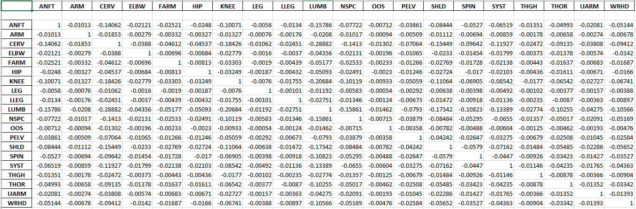
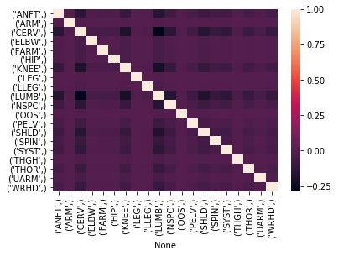
Correlation

Slide 41
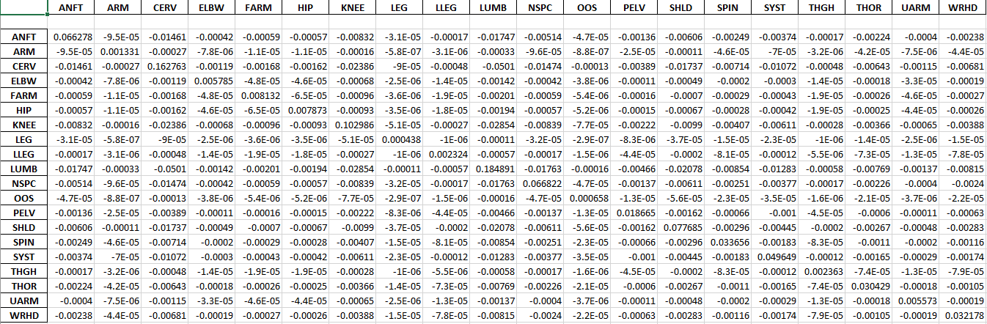
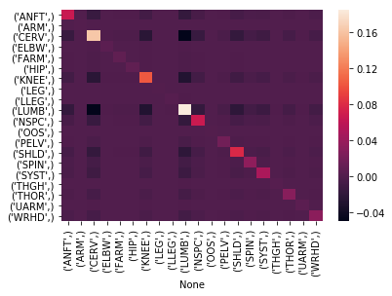
Covariance

Slide 42
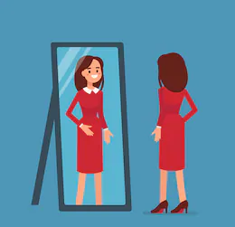
Reflective Behavior
The positive relationships were generally reflective
If a patient came in for a knee issue, then there is a positive covariance that if the patient returned, it would also be for a knee issue
Though this may seem intuitive, it is interesting to note that this positive pattern is not seen for every single (or even a majority) of the body parts
Rather, we see that lumbar, cervix, anterior foot, and knee problems are the most likely to have a patient return for the same issue

Slide 43
Preliminary Predictions

Slide 44
Predict Body Region with First Visit
Attempted to predict specific body region
Random Forest
Accuracy: 35.873%
R-squared: .112
Results not really explained by the model
Variables Used:
FVage
Gender
Allowed
Year
Month
Conclusion: not enough information on first visit to predict

Slide 45
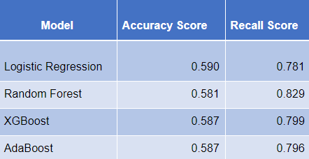
Predict Return for any other body region
Chosen model: Logistic Regression
Best accuracy score (our main consideration)
Similar recall score
Easy to understand

Slide 46
Aggregating the Data

Slide 47
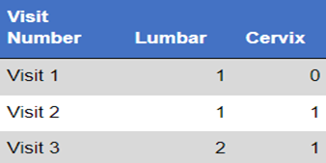
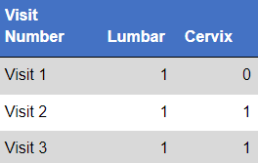
Aggregating the Data
Cumulative Aggregate
Binary Aggregate

Slide 48
Regression Results

Slide 49
Preface
In order to simplify the results, we used the six most frequently visited body regions as the six different dependent variables
Otherwise, having twenty different regressions would have been convoluted and not too insightful for business implications
These body regions included
ANFT
CERV
KNEE
LUMB
NSPC
SHLD
We also included the following control variables
MaxRisk
Gender(dummy coded)
FVage
Year
Month

Slide 50
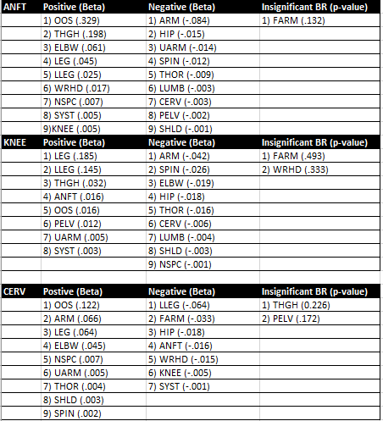
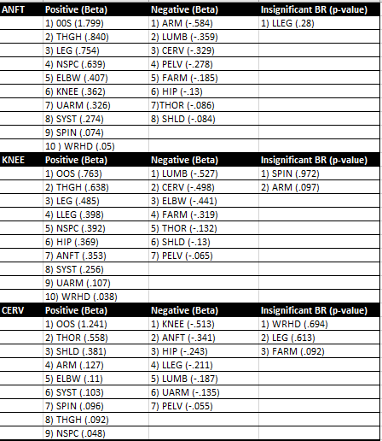
Regression Results
Notes:
Left cumulative right binary

Slide 51
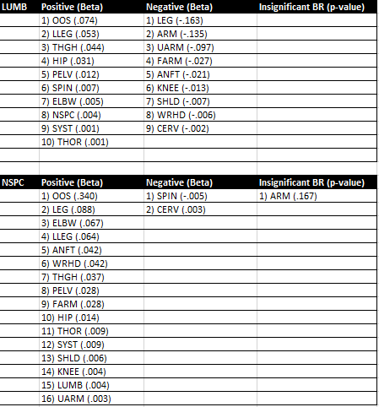
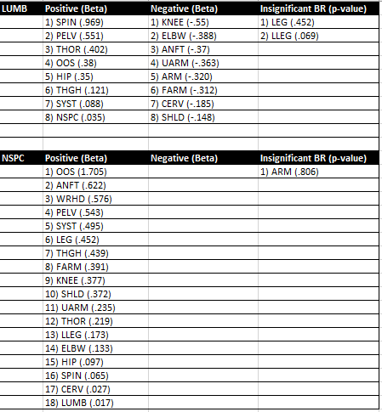
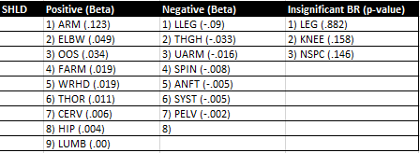
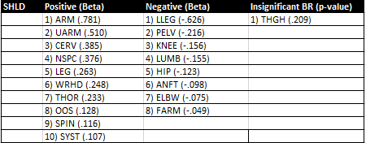
Regression Results Cont.

Slide 52
Results Explained
The way this can be read, for example let’s look at the regression with ANFT as the dependent variable.
If someone came in for an ARM injury previously:
Then using the beta coefficient of -.084 for ARM, we can say that this person has a (e^-.084) = 0.92 less likely of coming in for an ANFT compared to someone who had not previously come in for an ARM injury.
If the beta coefficient were positive, then the patient would be more likely to return.

Slide 53
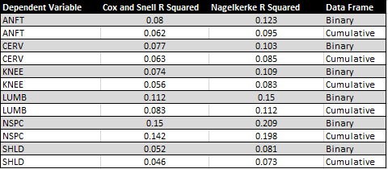
So which Dataset Should we Use?
The binary data frame out performed the cumulative data frame in every regression
Increase in control variables could increase performance of model
Binary also produced more intuitive results on a medical basis.
Example of this by looking at the LUMB regression

Slide 54
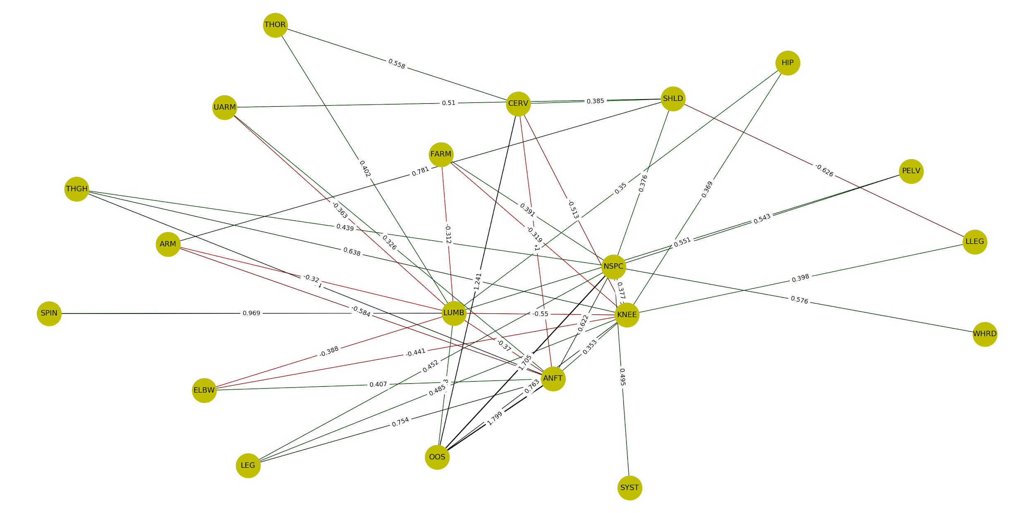

Slide 55
Business Implications for Body Region Model

Slide 56
Business Implications
Assist doctors in evaluating possible future injuries that a patient may come back for
Improve preventative treatment methods for patients
Help with staffing by seeing what type of specialists may need to be on hand if we know that a large portion of patients are going to visit in the future for a specific body region

Slide 57
Moving Forward

Slide 58
Summary
We built a logistic regression model to predict if a patient will return based off of their first visit information
We built a logistic regression model to predict if a patient will return for any other body region based off first visit information
We explored the associations between the body regions to identify the likelihood a patient would return for a certain body region based off the body regions which a patient had previously came in for

Slide 59
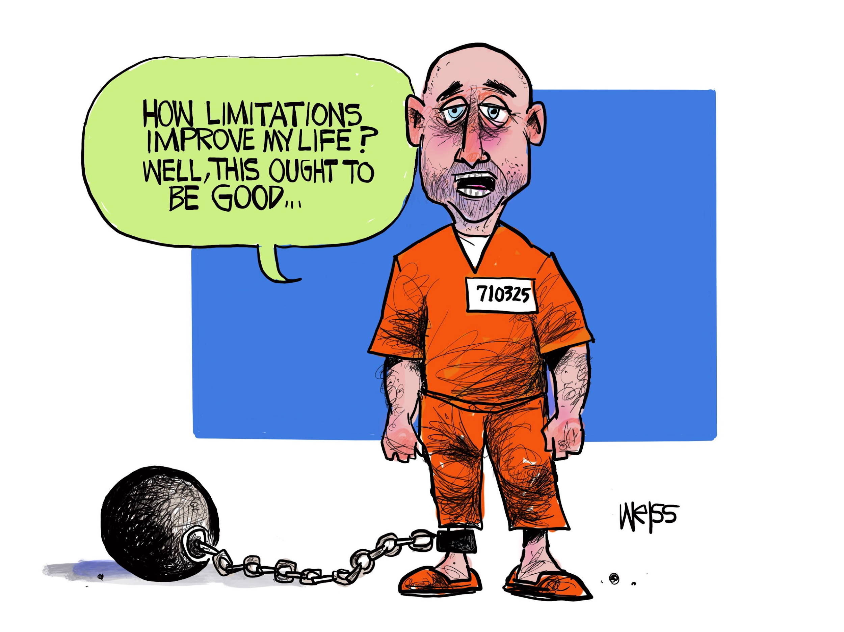
Limitations
Data did not contain the magnitude or severity of the injury for each visit
Only had the body region that was treated for each visit
This could help account for more of the randomness
We did not have the exact date of the visits
Amount allowed for treatments, not actual costs

Slide 60

Further Expansion of Study
Incorporation of cost
We had the allowed amount but that does not give full business insights
See whether it is worthwhile to keep offering a certain procedure or if it would be beneficial to offer certain procedures more often
Information on how injury occurred
Make the prediction model more robust
Better segment patients for analysis

Slide 61

Thank you!

